Slide 1
UnRestricted
Panagiota, Elliot, Favian,
Rumika, Neera

Slide 2
Hi-Fi Prototype
https://xd.adobe.com/view/20faabe3-b2d4-46e2-4bac-c04524f7ff83-56cb/?fullscreen&hints=off

Slide 3
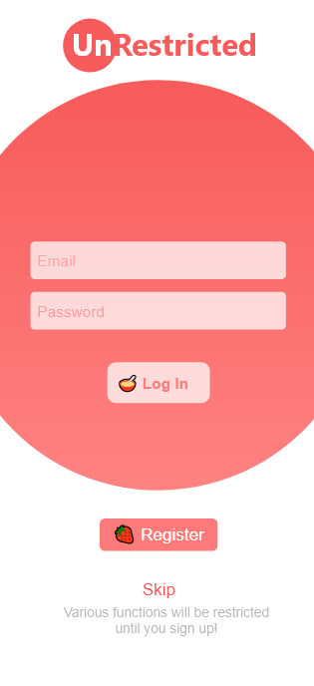
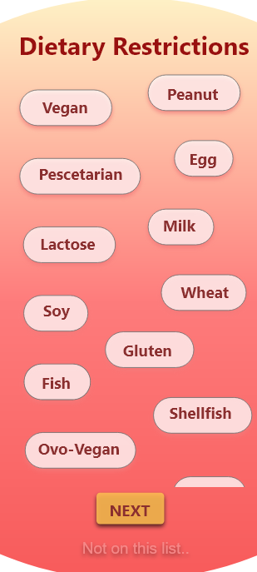
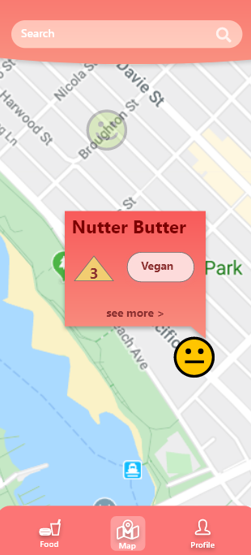
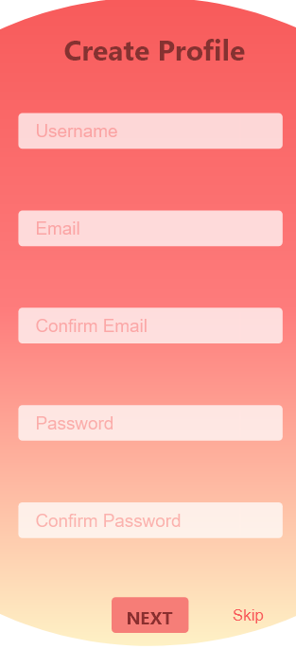
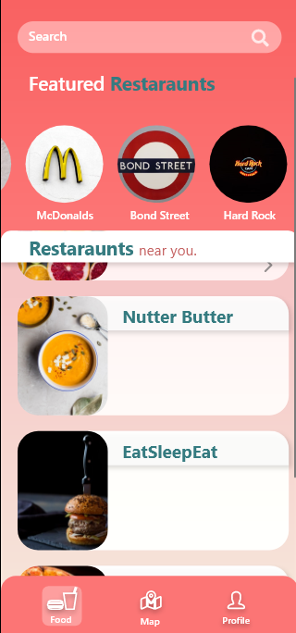
Attempted to take a slightly different approach to the search and map.
The initial design was very bare-bones.
Very focused on functionality not looks.

Slide 4
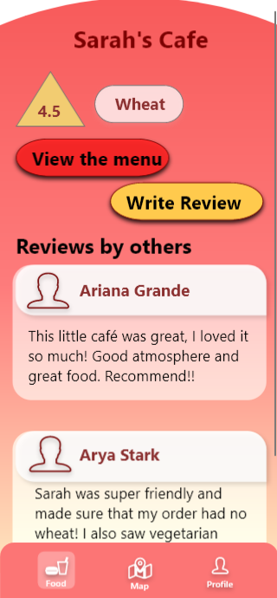
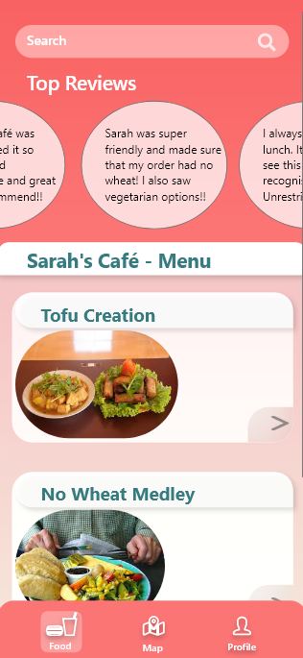
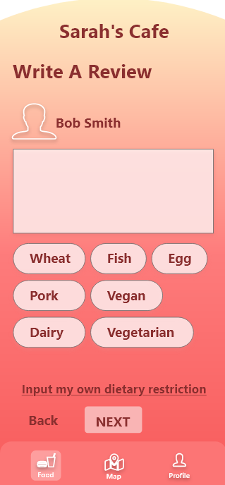
The summary screen of the restaurant turned out to have a redundant feature: top reviews.
Success or failure?
Review feature of the application was important to represent and update the restaurants most suited for the user.

Slide 5
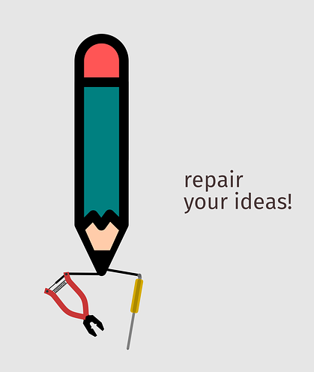
Summary of Heuristic Evaluation
Critical issues that needed to be addressed:
Clear exits for users on every screen
Pop-up error messages if user makes mistake
Keeping the prototype consistent (style, design, buttons..)
Other issues that were addressed:
Better Navigation with the map and improved icons
Freedom to edit/create dietary restrictions, and edit profile
Main UI feature: Map Icons for restaurants

Slide 6

Summary of Heuristic Evaluation
Aspects of the prototype we did well:
Minimalistic approach made it easy to maneuver
Icons used in the prototype are easy to understand
Consistency is there, but no two screens are the exact same - keeps it interesting

Slide 7
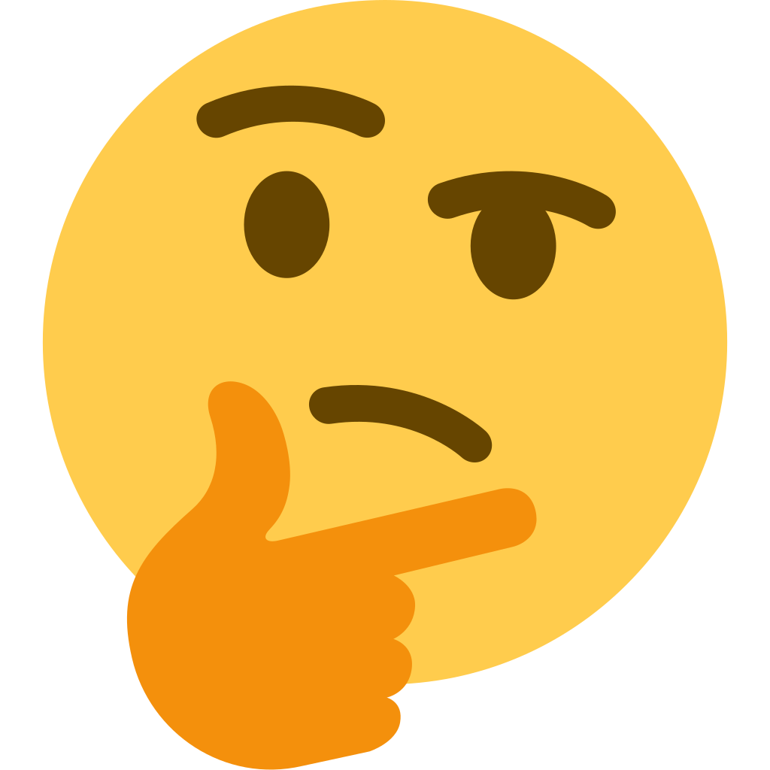
Summary of Heuristic Evaluation
Aspects of the application that we did not change:
Help/Documentation page
Different colours for map icons
Red colour as main colour for the application

Slide 8
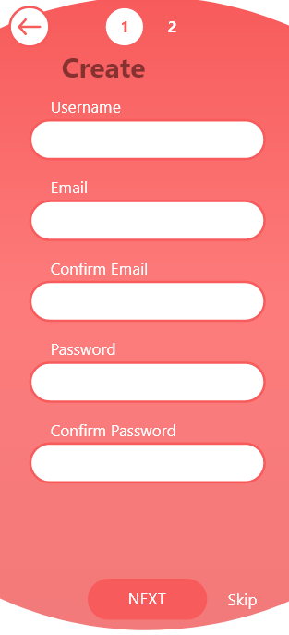
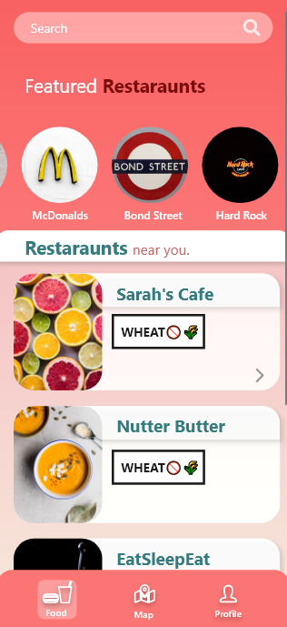
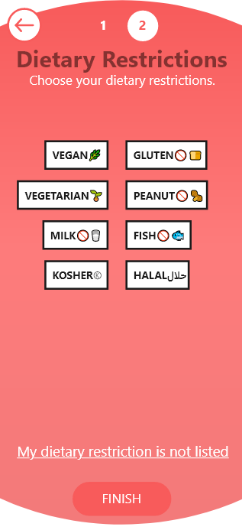
School Name
Anytown, ST
MBA: May 20XX
School Name
Anytown, ST
BS, Computer Science: May 20XX
School Name
Anytown, ST
AdTech Lab: January 20XX

Slide 9
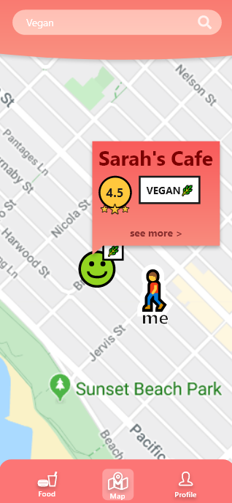
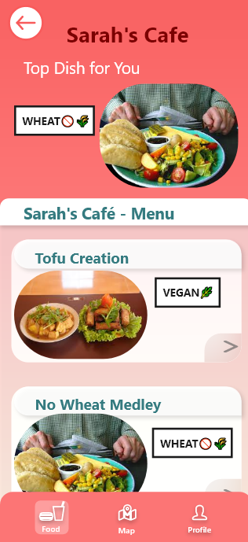
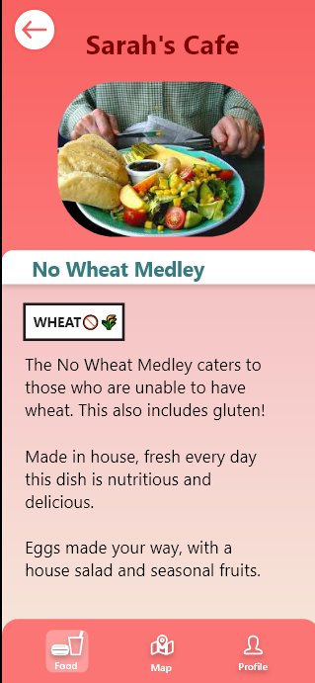

Slide 10
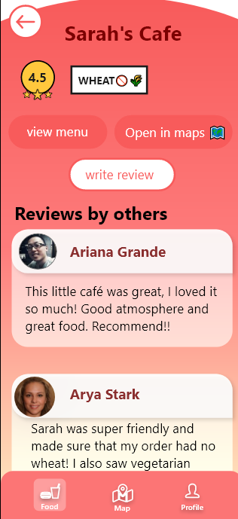
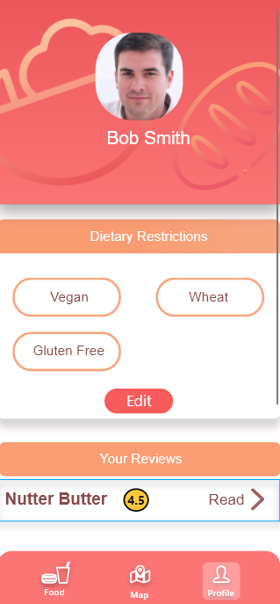
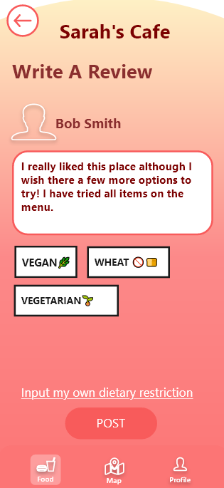

Slide 11

UnRestricted
Thank you!
Questions?

